Slide 1
Business Plan Module 1
Dr. M. Tariq Yousafzai

Slide 2





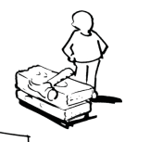




Business Model Canvas - Template – Assignment No 2 (related to your business Plan
Key Partners | Key Activities | Value Propositions |  | Customer Relationships | Customer Segments
 | Key Resources |  |  | Channels
Cost Structure |  |  | Revenue Streams
Social & Environmental Cost |  |  | Social & Environmental Benefit
http://www.businessmodelgeneration.com

Slide 3

I. Executive Summary
Snapshot of entire business plan to be discussed at the end.

Slide 4
II. THE INDUSTRY AND THE COMPANY AND ITS PRODUCT(S) OR SERVICE(S)
A major area of consideration is the company, its concept for product(s) and service(s), and its interface with the industry in which it will be competing.
This is the context into which the marketing information, for example, fits in.
Information needs to include a description of the industry, a description of the concept, a description of the company and a description of the product(s) or service(s) you will offer, the proprietary position of these products(s) or service(s), their potential advantages, and entry growth strategy for the product(s) or service(s).

Slide 5
II. THE INDUSTRY AND THE COMPANY AND ITS PRODUCT(S) OR SERVICE(S) Continued…
The industry:
Present the current status and prospects for the industry in which the proposed business will operate.
Discuss briefly Market size, Growth Trends, and competitors
Discuss any new products or developments, new products and customers, new requirements, new entrants and exits, and any other national or economic trends and factors that could affect the venture’s business positively or negatively.

Slide 6
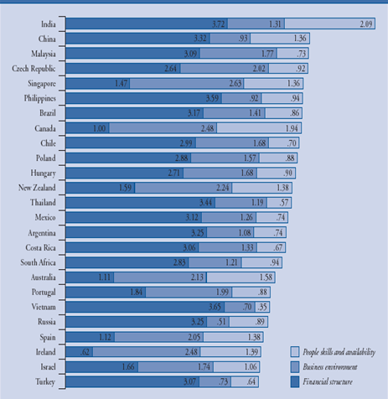
Offshore location attractiveness index

Slide 7
sectionc

Slide 8
II. THE INDUSTRY AND THE COMPANY AND ITS PRODUCT(S) OR SERVICE(S)
B. The Company and the concept
Describe what business your company is in or intends to enter, what products/service will it offer, and who will be its principal customers.
If your company has been in business for several years and is seeking expansion financing, review its history and cite its prior sales and profit performance, and if your company had setbacks or losses in prior years, discuss these and emphasize current and future efforts to prevent a recurrence of these difficulties and to improve your company’s performance.

Slide 9
II. THE INDUSTRY AND THE COMPANY AND ITS PRODUCT(S) OR SERVICE(S)
C. The Product(s) or service(s)
Describe in some detail each product or service to be sold
Discuss the application of product or service and describe the primary end use as well as any significant secondary applications (Haier)
Describe your USP; also describe what is currently on the market and what will you offer that will account for your market penetration
Include a description of any possible drawbacks (including problems with obsolescence) of product or service

Slide 10
II. THE INDUSTRY AND THE COMPANY AND ITS PRODUCT(S) OR SERVICE(S) cont’d
D. Entry and growth strategy:
Indicate key success variable in your marketing plan (e.g., an innovative product, timing advantage, or marketing approach) and your pricing, distribution, advertising and promotional plans.
Summarize how fast you intend to grow and to what size during the first five years and your plans for growth beyond your initial product or service
AVOID THE SHINY OBJECT SYNDROME

Slide 12
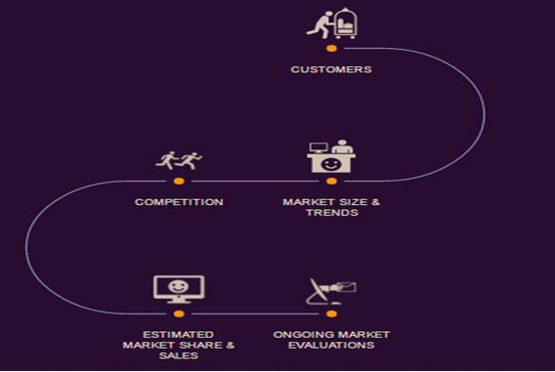
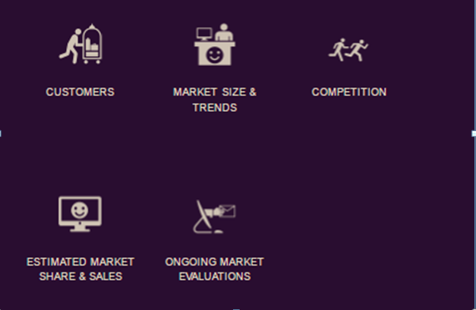
Market Research and Analysis

Slide 14

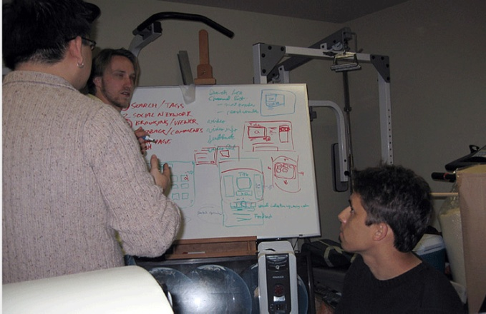

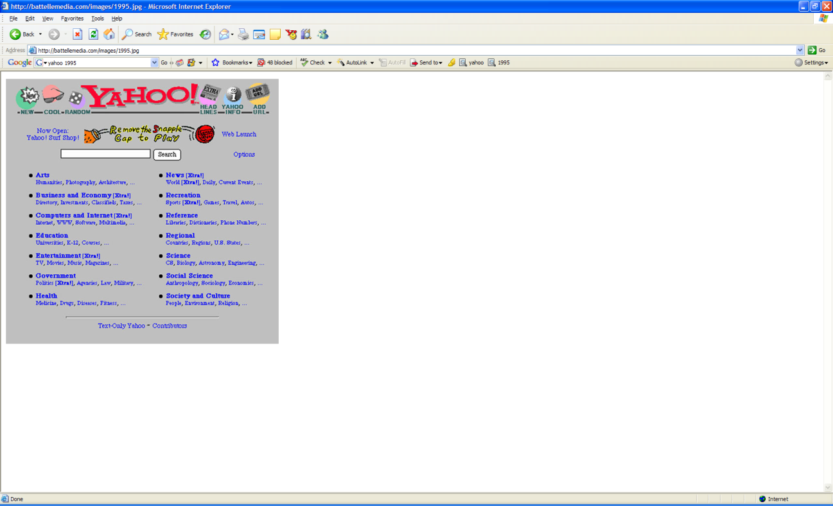
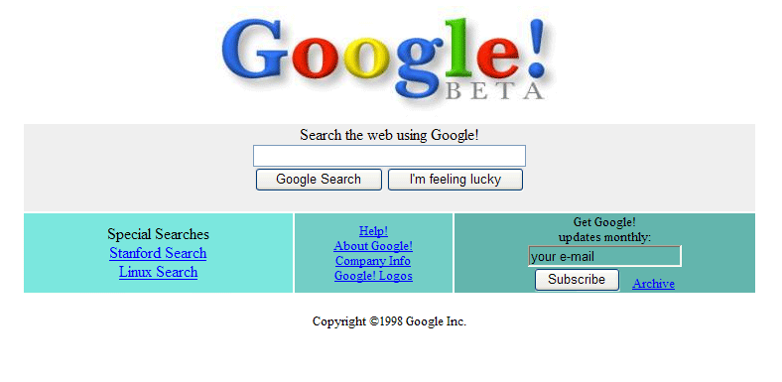
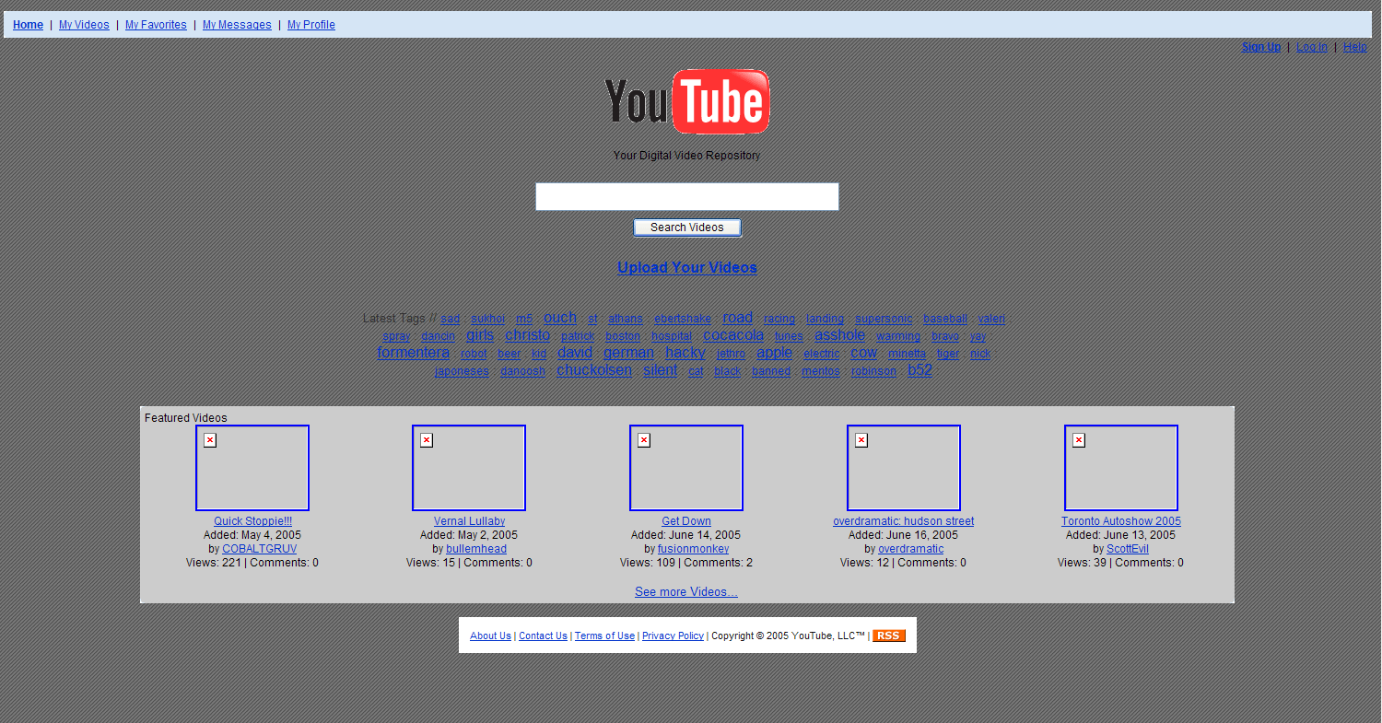
HUMBLE BEGINNINGS
Steve Chad Jawed
Jerry & David
Larry & Sergey
Notes:
Jerry Yand and David Filo

Slide 15
III. MARKET RESEARCH AND ANALYSIS
Due to critical dependence of other parts of the plan on this section, you are advised to prepare this section before any other.
Check the market (Present or future)
Check alternative sources of market data and take time on this part (Prefeasibility studies available at SMEDA website)
Important because predicted sales levels directly influence such factors as the size of manufacturing operation, the marketing plan and the amount of debt and equity capital you will require

Slide 16
III. MARKET RESEARCH AND ANALYSIS
Customers
Discuss who the customers for the product(s) or service(s) are or will be.
Note that potential customers need to be classified by relatively homogenous groups having common, identifiable characteristics (e.g., by market characteristics)
For example, automotive part might be sold to manufacturers and to parts distributors supplying the replacement market, so the discussion needs to reflect two market segments.
If you have existing business, list your principal current customers and discuss the trends in your sales to them.

Slide 17
Segmentation Bases
By Behavior | By Demography | By Geography | By Psychographics
-Benefit sought from the product -How often the product is used (usage rate) -Usage situation (daily or holiday use) -Buyers status and loyalty to the product (non-user, first time user, regular) | -Age/ Generation -Income -Gender -Family lifecycle -Family size -Occupation -Nationality | -Region (Region Continent, Country, State) -Size of city or town Population density Climate | Activities Interests Opinions

Slide 18
IMPORTANT BEFORE YOU PROCEED ANY FURTHER Entrepreneurial plans
ORDINARY PLAN
Is for existing organisation
Proposes incremental changes
Projections based on past achievements
ENTREPRENEURIAL PLAN
Is for new organisation
Proposes a radical change (an innovation)
No historic basis for projections

